Slide 1
Module 9: Address Resolution
Introduction to Networks v7.0 (ITN)
Notes:
Cisco Networking Academy Program
Introduction to Networks v7.0 (ITN)
Module 9: Address Resolution

Slide 2
9.1 MAC and IP
Notes:
9 - Address Resolution
9.1 MAC and IP

Slide 3
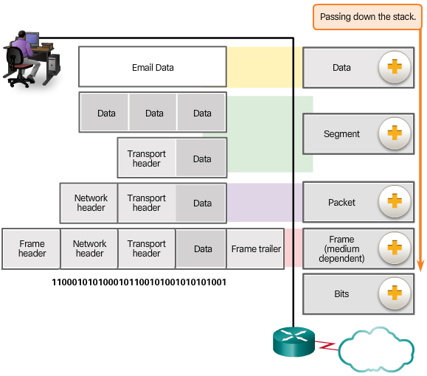
Protocol Data Units
Encapsulation
Data
Segment
Packet
Frame
Bits
Notes:
3.3.1.2 Protocol Data Units

Slide 4
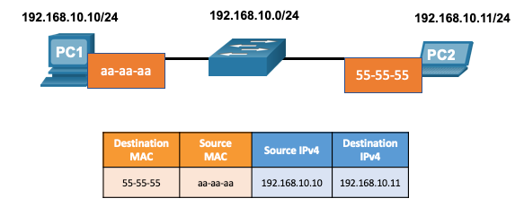
MAC and IP Destination on Same Network
There are two primary addresses assigned to a device on an Ethernet LAN:
Layer 2 physical address (the MAC address) – Used for NIC to NIC communications on the same Ethernet network.
Layer 3 logical address (the IP address) – Used to send the packet from the source device to the destination device.
Layer 2 addresses are used to deliver frames from one NIC to another NIC on the same network. If a destination IP address is on the same network, the destination MAC address will be that of the destination device.
Notes:
9 – Address Resolution
9.1 – MAC and IP
9.1.1 – Destination on Same Network

Slide 5
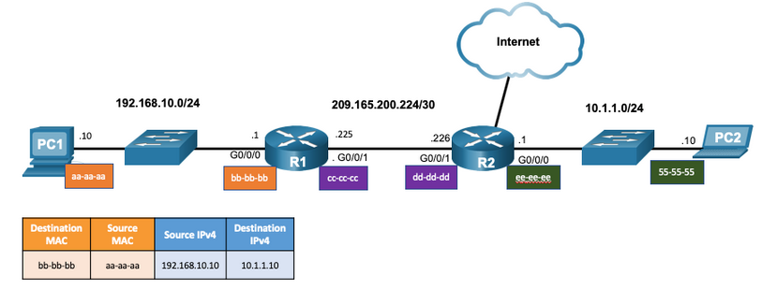
MAC and IP Destination on Remote Network
When the destination IP address is on a remote network, the destination MAC address is that of the default gateway.
ARP is used by IPv4 to associate the IPv4 address of a device with the MAC address of the device NIC.
ICMPv6 is used by IPv6 to associate the IPv6 address of a device with the MAC address of the device NIC.
Notes:
9 – Address Resolution
9.1 – MAC and IP
9.1.2 – Destination on Remote Network

Slide 6
9.2 ARP
Notes:
9 - Address Resolution
9.2 ARP

Slide 7
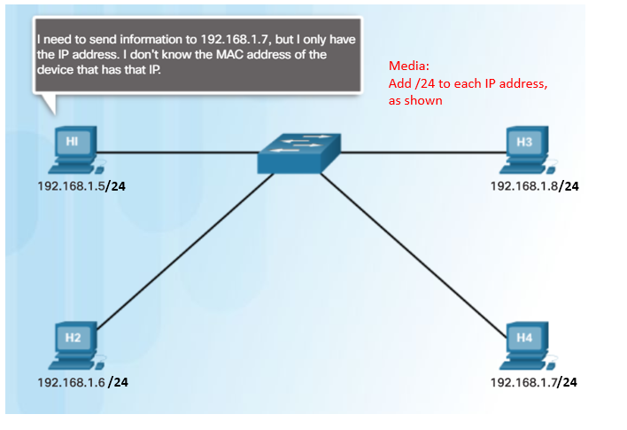
ARP ARP Overview
A device uses ARP to determine the destination MAC address of a local device when it knows its IPv4 address.
ARP provides two basic functions:
Resolving IPv4 addresses to MAC addresses
Maintaining an ARP table of IPv4 to MAC address mappings
Notes:
9 – Address Resolution
9.2 – ARP
9.2.1 – ARP Overview

Slide 8
ARP ARP Functions
To send a frame, a device will search its ARP table for a destination IPv4 address and a corresponding MAC address.
If the packet’s destination IPv4 address is on the same network, the device will search the ARP table for the destination IPv4 address.
If the destination IPv4 address is on a different network, the device will search the ARP table for the IPv4 address of the default gateway.
If the device locates the IPv4 address, its corresponding MAC address is used as the destination MAC address in the frame.
If there is no ARP table entry is found, then the device sends an ARP request.
Notes:
9 – Address Resolution
9.2 – ARP
9.2.2 – ARP Functions

Slide 9
ARP Video - ARP Request
This video will cover an ARP request for a MAC address.
Notes:
9 – Address Resolution
9.2 – ARP
9.2.3 – Video - ARP Request

Slide 10
ARP Video – ARP Operation - ARP Reply
This video will cover an ARP reply in response to an ARP request.
Notes:
9 – Address Resolution
9.2 – ARP
9.2.4 – Video – ARP Operation - ARP Reply

Slide 11
ARP ARP Tables on Networking Devices
The show ip arp command displays the ARP table on a Cisco router.
The arp –a command displays the ARP table on a Windows 10 PC.
R1# show ip arp
Protocol Address Age (min) Hardware Addr Type Interface
Internet 192.168.10.1 - a0e0.af0d.e140 ARPA GigabitEthernet0/0/0
C:\Users\PC> arp -a
Interface: 192.168.1.124 --- 0x10
Internet Address Physical Address Type
192.168.1.1 c8-d7-19-cc-a0-86 dynamic
192.168.1.101 08-3e-0c-f5-f7-77 dynamic
Notes:
9 – Address Resolution
9.2 – ARP
9.2.7 – ARP Tables on Networking Devices

Slide 12
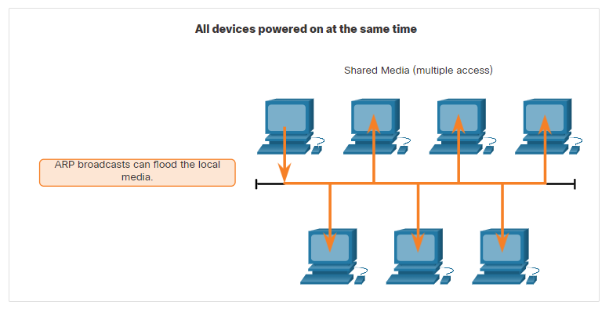
ARP ARP Issues – ARP Broadcasting and ARP Spoofing
ARP requests are received and processed by every device on the local network.
Excessive ARP broadcasts can cause some reduction in performance.
ARP replies can be spoofed by a threat actor to perform an ARP poisoning attack.
Enterprise level switches include mitigation techniques to protect against ARP attacks.
Notes:
9 – Address Resolution
9.2 – ARP
9.2.8 – ARP Issues – ARP Broadcast and ARP Spoofing

Slide 13
9.3 IPv6 ND
Notes:
9 - Address Resolution
9.3 Copper Cabling

Slide 14
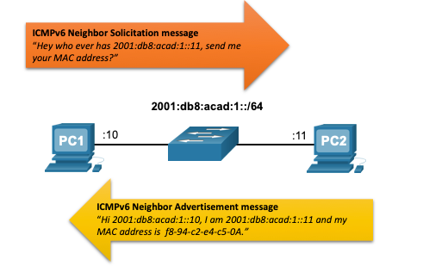
IPv6 Neighbor Discovery IPv6 Neighbor Discovery – Address Resolution
IPv6 devices use ND to resolve the MAC address of a known IPv6 address.
ICMPv6 Neighbor Solicitation messages are sent using special Ethernet and IPv6 multicast addresses.
Notes:
9 – Address Resolution
9.3 – IPv6 Neighbor Discovery
9.3.3 – IPv6 Neighbor Discovery – Address Resolution

